Slide 1
Domain-Driven Design
In the AI Era
Peter Ritchie

Slide 2
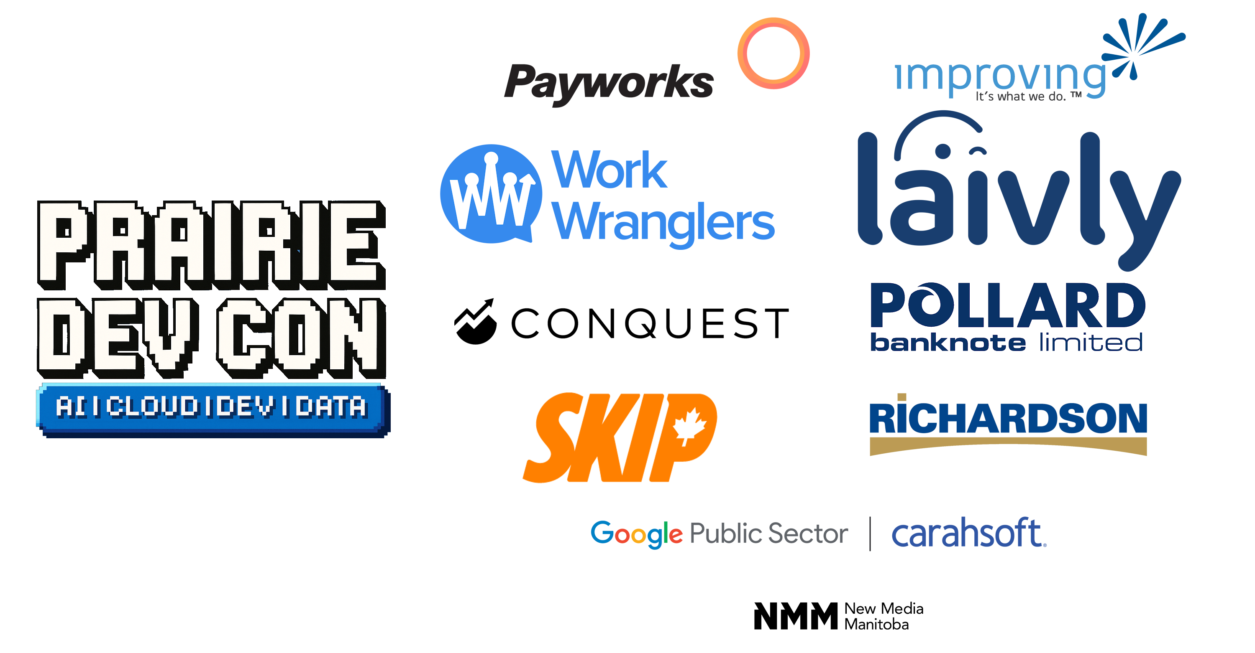

Slide 3
About me
Freelance technologist specializing in helping teams deliver software solutions
  Software Architect
  Fractional Solution Architect
  Fractional Developer Lead
In industry for over 30 years
Author of 3 books on .NET Development
Former Microsoft MVP award in .NET (13), ASP.NET Insider
Certified Azure, SAFe, and SOA

Slide 4
About me
Session Materials: https://bit.ly/4AzTYvJ
https://blog.peterRitchie.com
https://github.com/peteraritchie
https://www.linkedin.com/in/peteraritchie
https://bsky.app/profile/peterritchie.com
peter@peterRitchie.com

Slide 5
Agenda
What AI is and isn’t
AI features and caveats
Domain-Driven Design features and caveats
Goals of AI use with Domain-Driven Design
Shifting insight left
AI in strategic design
AI in tactical implementation

Slide 6
What AI is and isn’t

Slide 7
What is AI (Large Language Models, Agents)
A natural language processing tool
Generative Pre-trained Transformer
  Generate new information from prompt and context
Statistical prediction engine
  guesses the next word or token in a sequence based on patterns learned from vast amounts of text
May predict information never stated before (generative)
Uses semantics (meaning) to connect related information

Slide 8
AI Features
LLMs
  Stateless generation
  Language understanding
  In-context “learning”
Agents
  Agentic loop
  Tool usage
  Memory management
Context window attention

Slide 9
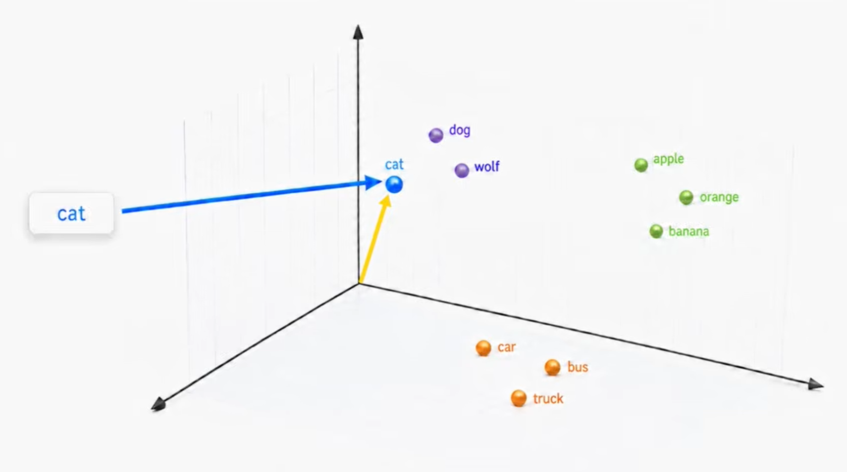
Semantic similarity

Slide 11
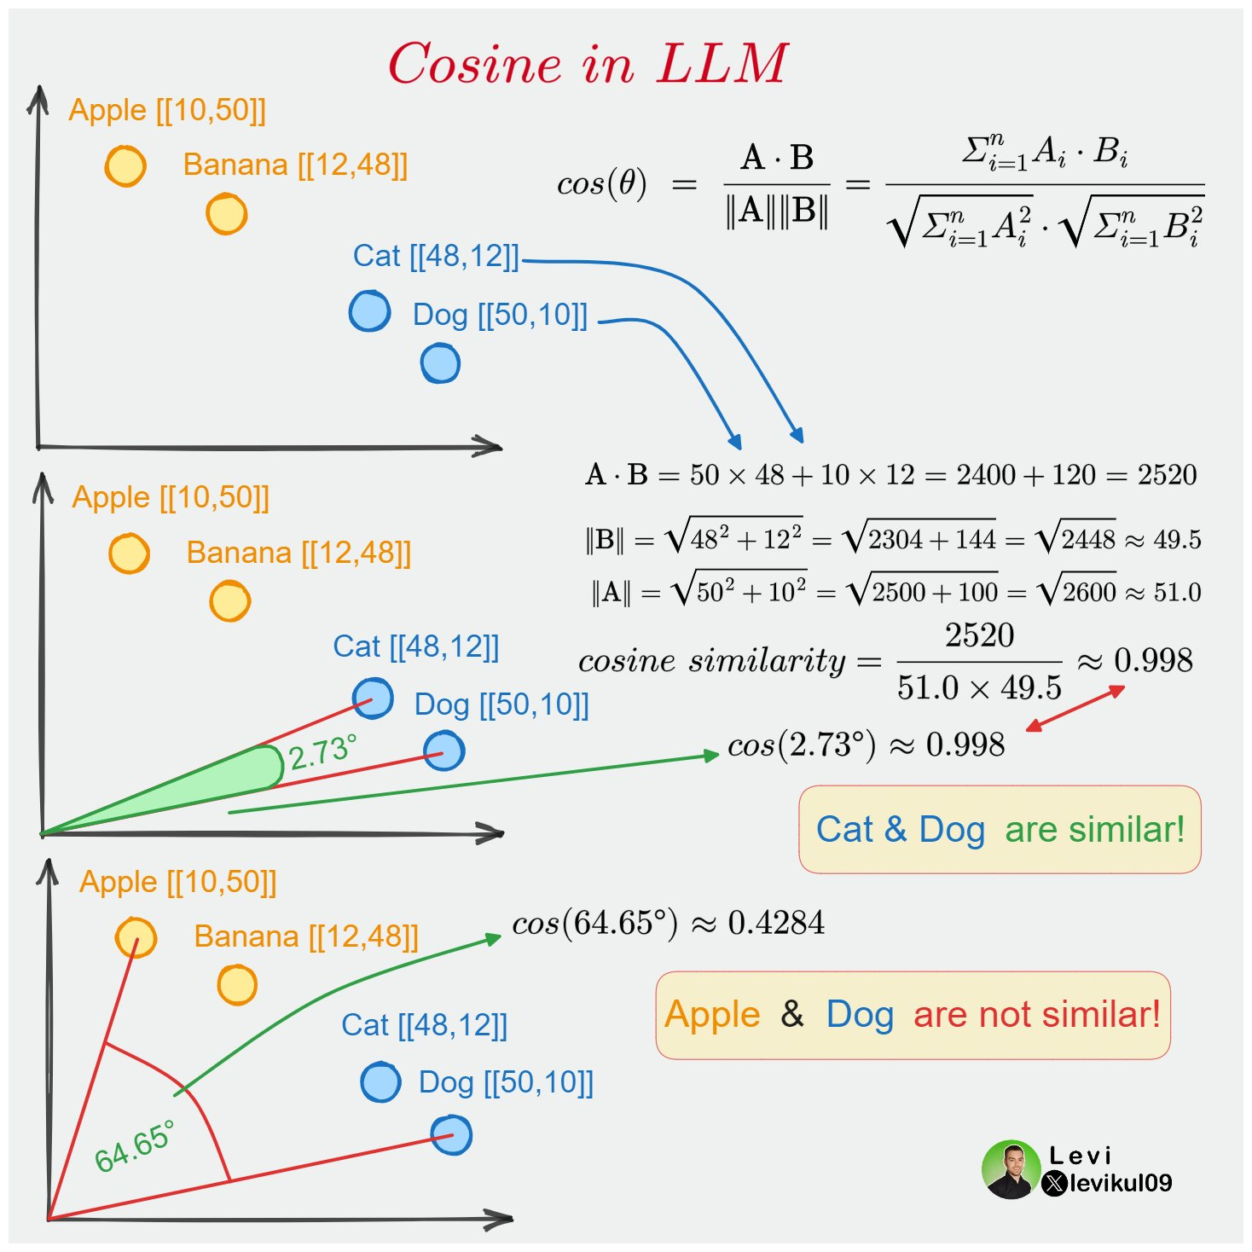
Semantic similarity

Slide 13

AI is another tool

Slide 15
AI isn’t…
Magic
Able to reason, be objective, or have conscious
Better than the information it was trained on
  Repeats, amplifies whatever it’s trained on
Deterministic

Slide 16
LLM Risks
Uses a prediction that isn’t real
Hallucinations
  Predicted information that was mathematically likely, but not true
Bad training data
Biased training data
Misinterpreted data
Amplification of error and technical debt

Slide 17
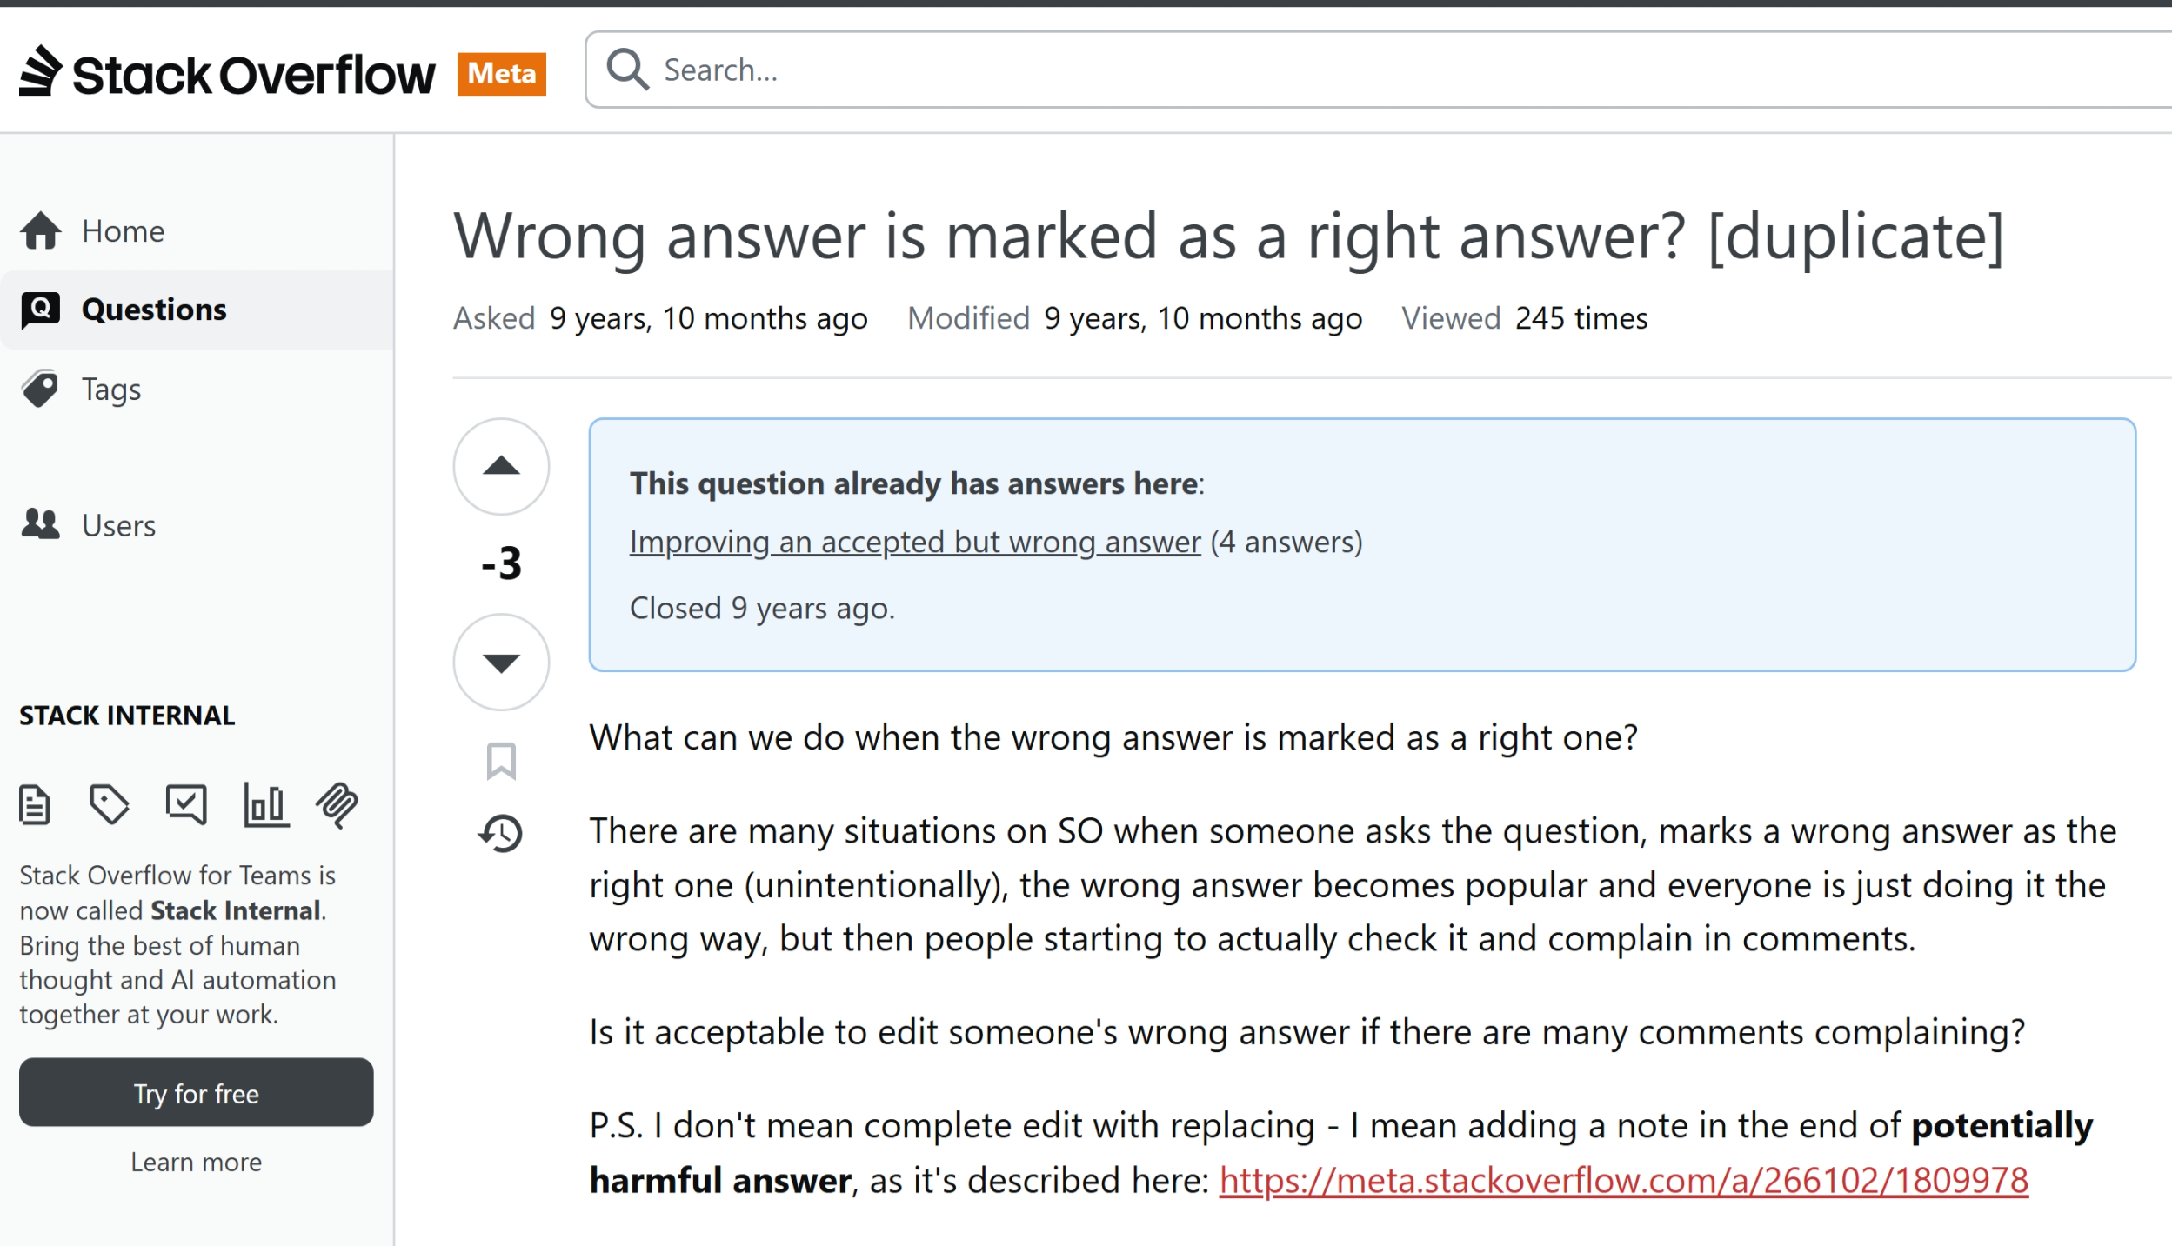
Not all data is good data

Slide 19
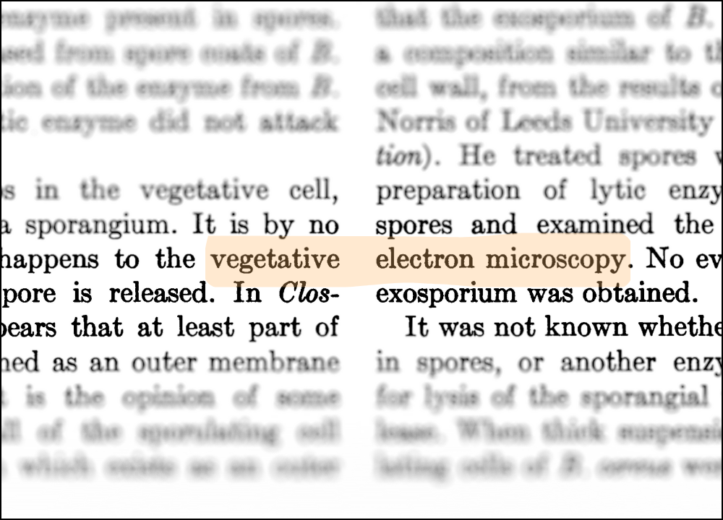
Misinterpreted data

Slide 21
Domain-Driven Design features and risks

Slide 22
Goals of Domain-Driven Design
Recognize and address complexity
Achieve common understanding of business domain
  Described in a domain model, using a single business language
Structure and build software directly mirroring the business domain and its language
Refine domain understanding through learned insights
Focus on the domain and the domain logic
  Isolation and modularization of domain from other concerns

Slide 23
Complexity
10
9
11
8
12
7
1
6
2
5
3
4

Slide 24
10
9
11
8
12
7
1
6
2
5
3
4

Slide 25
Simplification through organizataion
10
9
11
8
12
7
1
6
2
5
3
4

Slide 26
10
9
11
8
12
7
1
6
2
5
3
4

Slide 27
Simplification through isolation
5
4
5
9
5
5
8
1
2
5
11
5
3
6
7
10

Slide 28
5
4
5
9
5
5
8
1
2
5
11
5
3
6
7
10

Slide 29
Strategic Design
5
4
5
9
5
5
8
1
2
5
11
5
3
6
7
10

Slide 30



5
4
5
9
5
5
8
1
2
5
11
5
3
6
7
10

Slide 31
Continuous Discovery and Refinement
Iterative
^
Model
Analyze
Agree
Plan
Architecture
Deliver
Implement
Verify
Learn
Design
Refactor
Observe

Slide 32
Domain-Driven Design risks
Introduce a different type of complexity (accidental complexity)
A focus on technical patterns instead of the domain
Ambiguity
  Lack of access to domain experts
  Guessing at requirements
Failing to recognize the behavior in the domain

Slide 33
Goals of use of AI with Domain-Driven Design

Slide 34
Reduce time to market/production
Objective: Reduce requirement ambiguity
  Allow AI to rapidly predict edge cases and lack of clarity
  Present questions, options to increase clarity
Objective: Generate boilerplate code
  Allow AI to predict how well-known logic should look in our context
Objective: Reduce tech debt
  Utilize AI to more closely align code with requirements

Slide 35
Increase quality
Objective: Discover and emphasize unquantifiable requirements
  Reduce ambiguity and scope, and increase validatability
Objective:
  Increase unit test coverage
Objective:
  Review code against business, team, and technical expectations

Slide 36
Increase adaptability/maintainability
Objective: Summarize code blocks and document code bases
  Understand a code base
  Compare our understanding with AIs summarization
Objective: refactor code for structure
  Make code more cohesive through re-organization
Objective: refactor code for pattern usage
  Call out explicit pattern usage to code more self-documenting

Slide 37
Shifting insight left

Slide 38
Guiding Agents on the Domain
Avoid being based solely on public information
Provide guardrails and scope
Focus agent on domain and proprietary information
Breaking tasks down to accommodate granular insight
Review output and refine frequently
Avoid “Vibe Coding”

Slide 39
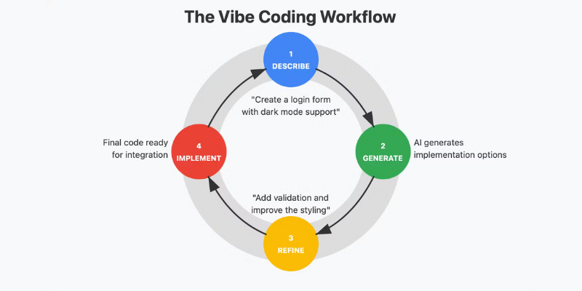
Hard to Shift Left

Slide 40
Prompt
Generate
Generate
Prompt

Slide 41
Session
Code
Agent/Model
Code
Code
Context
Input
Output
Prompt 1
Merge
Code
Agent/Model
Code
Context
Code
Input
Output
Prompt 2

Slide 42
Surface Area to Shift Left
Review
Review
Review
Requirement
Plan solution
Analyze tasks
Execute
Deliver
Clarify requirement
Specify feature
Breakdown tasks
Review
Review
Review

Slide 43
Demo

Slide 44
Take aways

Slide 45

Right tool for the job

Slide 46
Be strategic and proactive
Objective: Understand the benefits of LLMs
  Anticipate and measure the outcomes of AI usage
Objective: Measure increased value
  Rather than mere token/credit usage
  Transition from “Am I using AI” to “What value is AI adding”
Objective: Work LLMs into existing practices and workflows
  Not only code generation
  LLMs usage can replace some things, but not all things
  Work LLM usage into processes intentionally

Slide 47
Tailored AI Usage
Core Domain
  Complex competitive advantage
  Detailed guidance and instructions
Supporting Domain
  Recognize non-proprietary behaviors
Generic Domain
  Offload to AI as much as possible
Small steps
  Feature by feature

Slide 48
Be Realistic
You’re responsible for your use of generative AI
  “AI can make mistakes, so double-check responses”
Don’t use it for the sake of using it
  Question mandates to use it “everywhere” for “everything”
Only use it where it adds value
  Complex problems
Recognize future insights and current tech debt
  Don’t rely on reverse engineering a code base

Slide 49
Other Recommendations
Human in Loop
  Break agent usage into phases, review results of each
  Leverage AI for tasks decomposition and planning
Prefer “how” in guidelines as strategy or tactics
  E.g. copilot-instructions.md, not constitution.md
Focus on why and what and success criteria in features
  Avoid constraints in features/specs

Slide 50



References
 | G. Sutton, “Timeless Algorithms, The Foundational Ideas”. Manning Custom Instructions vs Custom Agents vs Agent Skills (Explained) E. Evans, “Domain-Driven Design Reference”. Domain Language Spec-Driven Development Quickstart

Slide 51
Thank you!
Session Materials: https://bit.ly/4AzTYvJ
https://blog.peterritchie.com
https://github.com/peteraritchie
https://www.linkedin.com/in/peteraritchie
https://bsky.app/profile/peterritchie.com
peter@peterRitchie.com

